Slide 1

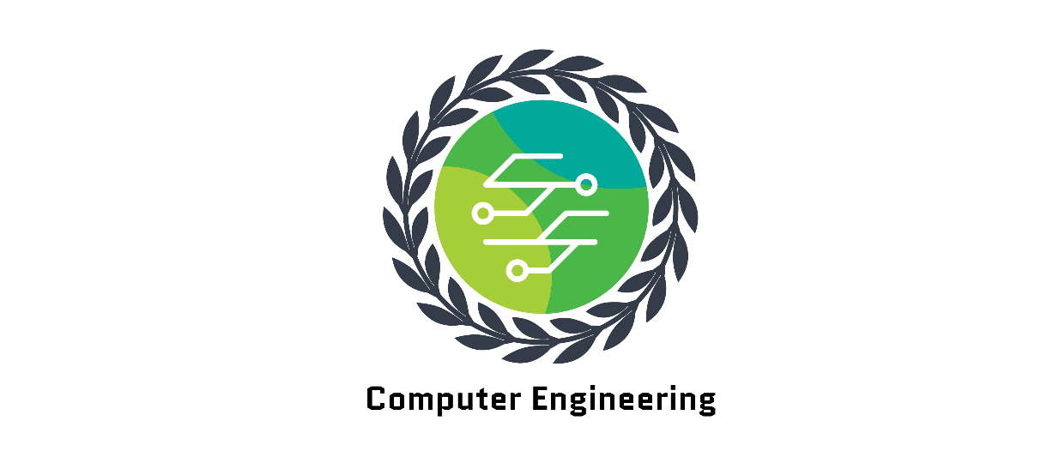
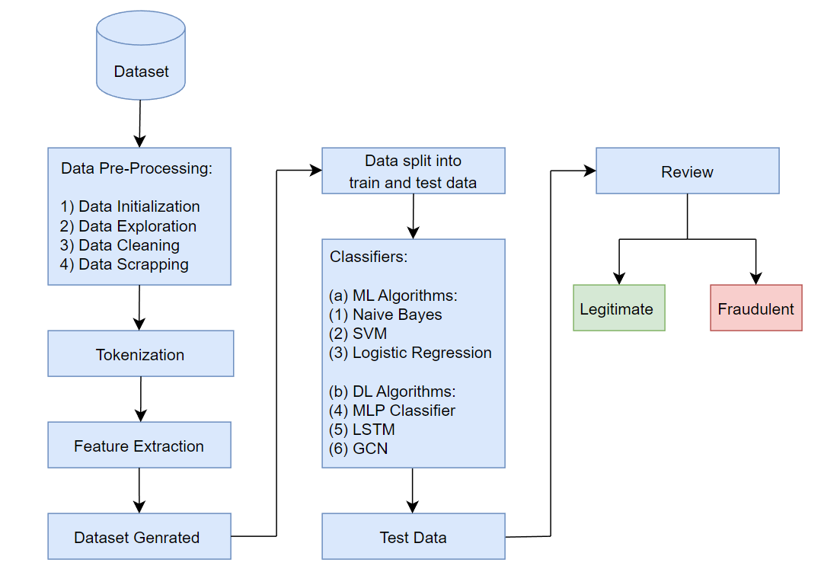
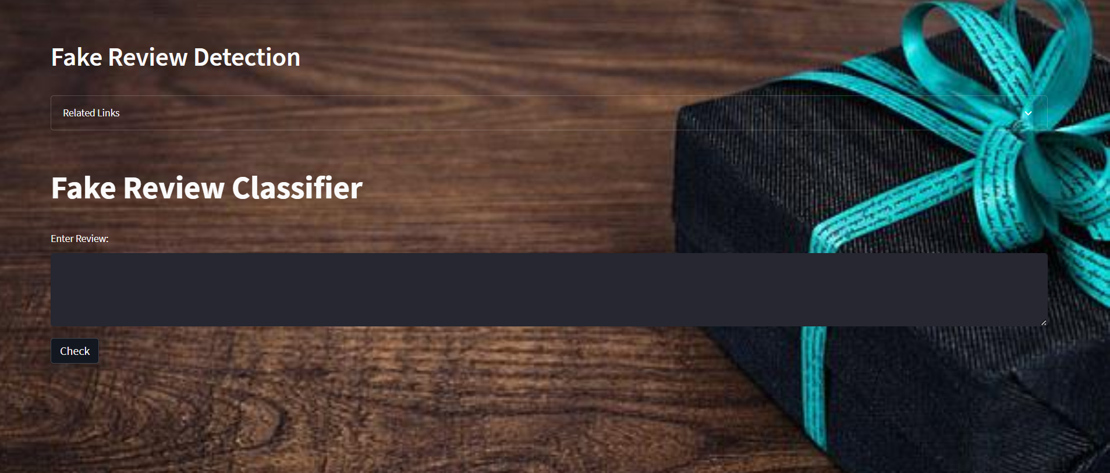
Fake Review Detection Using GNN
Yash P, Amish N, Sumati H, Akshen D
Guide: Prof. Bharti Khemani
Abstract
Objectives
Fake reviews are a significant problem in online review platforms, where they can skew the reputation of products and businesses. Detecting such reviews is essential for ensuring the credibility of these platforms and protecting consumers from misleading information.
Our project provides an overview of various techniques that have been developed to identify fake reviews, including natural language processing, machine learning & deep learning algorithms, and analyzing reviewer behavior and history.
We also discuss the impact of fake reviews on online review platforms and businesses and highlights the need for continued research in this area.
To obtain a cleaned and labelled dataset, we must acquire the data, preprocess it, tokenize it, and extract its features.
To test and validate the performance of E-Commerce fake reviews detection.
To evaluate & analyze the performance of different models.
To deploy the model, once ready.
Project Scope
Result
Architecture Diagram
User Interface
Conclusion
Future Scope
The use of various algorithms, mainly GNN for e-commerce has shown to be a highly effective method for identifying bogus reviews.
Businesses may quickly and effectively spot fraudulent reviews by utilizing the power of these algorithms, and they can then take the necessary steps to safeguard their consumers and their reputation.
These algorithms enable e-commerce businesses to recognize and eliminate fraudulent reviews, ensuring that buyers are given genuine information about goods and services.
With the increasing use of e-commerce platforms, the need for detecting fake reviews is also increasing.
In the future, more sophisticated algorithms and techniques can be used to detect fake reviews.
Additionally, more data can be collected from different sources to improve the accuracy of the detection process.
Finally, more collaboration between e-commerce platforms and researchers can be done to develop better solutions.

